Slide 1

“In The Name of Almighty Allah Who is the Beneficent the Merciful”

Slide 2

By Ali Hussain Huma Tariq Abdullah Shakeel Jiyad khan Adeen zainub
Presentation:

Slide 3

Role of Psychology in Daily life Data Science and Artificial Intelligence

Slide 4

Special thanks to;
Special Thanks to:
Ms. Farah Naz
Ms. Farah Naz

Slide 5
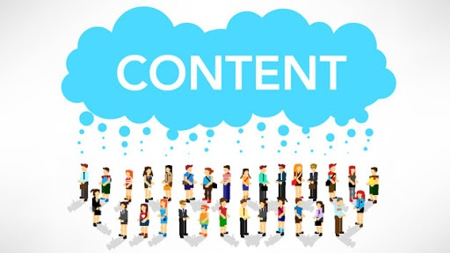
Role of Psychology in Daily life Data Science and Artificial Intelligence
Contents:
Introduction
Psychology and Daily life
Cognitive Psychology and Data Science
Psychology and Artificial intelligence
Cognitive Psychology and Cognitive Science
Theories of Psychology underlying daily life aspects
Theories of cognitive psychology underlying AI and Data Science
Conclusion

Slide 6



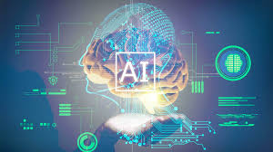
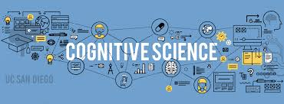
Introduction
Psychology
Data science
Ai
Cognitive science

Slide 7

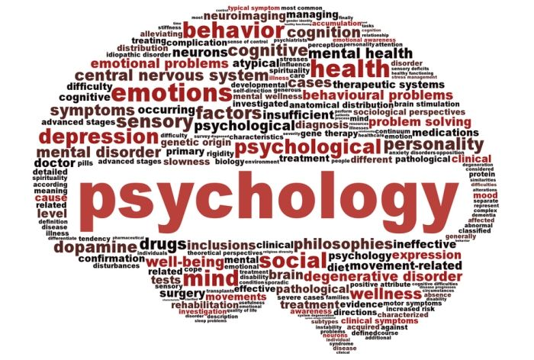
Psychology:
The word Psychology coined in 16th century from two Greek words “Psyche” meanings “Soul” and “Logos” meaning “study” thus anciently known as “Study of Soul”

Slide 8
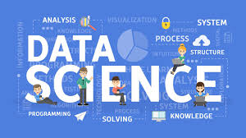


Data Science:
Data science is the implementation of different algorithms on scratch data to retrieve some useful patterns.

Slide 9


Artificial Intelligence:
Artificial Intelligence is consider as the capacity of an automated Computer or Commuter controlled machines or robot to perform different tasks commonly associated with humans or other animals

Slide 10
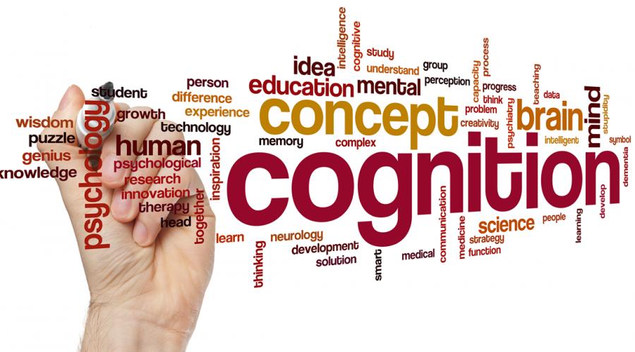
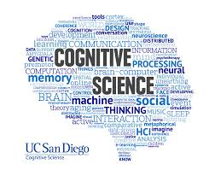
Cognitive Science:
Cognitive science is the scientific study of complex behavior, memory, perception, learning, analytical reasoning, problem solving concept formation and thought processes.

Slide 11

Psychology and Daily Life

Slide 12

1. Time Management

Slide 13

2. Strengthen your Relations:
The Expectancy Effect
Positive Social Support
Empathetic listening

Slide 14

3. Coping up with Stress

Slide 15

Psychology and Data Science

Slide 16
Psychology and Artificial Intelligence

Slide 17
Psychology and Artificial Intelligence
Many people are still amazed when they discover that I am a psychologist and also an AI specialist.
Both AI and psychology have a common axis.
Psychology deals with biological organisms, while AI deals with artificial cognitive systems.

Slide 18
Cognitive Psychology and Cognitive Science

Slide 19
Cognitive Psychology
Cognitive psychology is the scientific study of the mind as an information processor.
Cognitive psychologists develop a systematic understanding of cognitive processes.
Cognitive psychology is better understood as predominantly concerned with applied psychology.
Cognitive psychologists are often heavily involved in running psychological experiments.

Slide 20
Cognitive Science
Cognitive science is the scientific study of the mind and it process.
The goal of cognitive science is to understand the principles of intelligence.
Cognitive science is better understood as predominantly concerned with a much broader scope.
Cognitive science is highly involved in the area of artificial intelligence.

Slide 21
Theories of Psychology:
Behaviorism
(John Watson and B.F skinner)
Cognitivism
(Jean)
Psychodynamic theory
(Sigmund Fred)
Humanism
(Carl Roger and Abraham)

Slide 22
Role of psychology in daily life:
Behaviorism
Clinical psychology
Personality

Slide 23

Role of cognitive psychology artificial intelligence and Data Science:

Slide 24
Cognitive psychology and data science:
Big data
Data analysis
Data visualization

Slide 25
Cognitive psychology and AI:
Artificial intelligence
Human intelligence
Example:
Natural language processing
Alexa
Siri

Slide 26

Conclusion

Slide 27
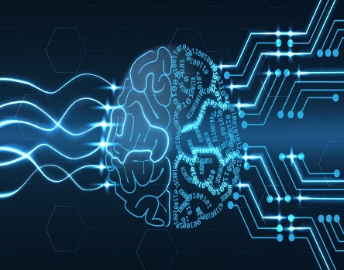
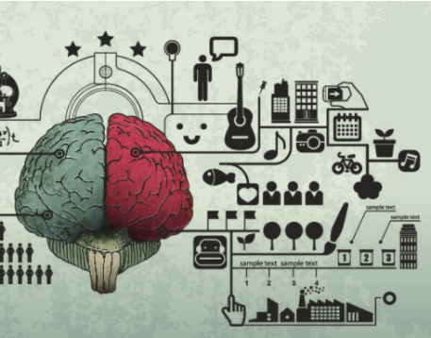
Role of Psychology in data science and artificial intelligence
Role of psychology in understanding human nature

Slide 28
“What you think, you become
What you feel, you attract
What you imagine, you create”
-BUDDHA

Slide 29

Questions

Slide 30

Thank you!

